Slide 1

Visualization of 3D
data for Education
CS567 - Fall 2021

Slide 2
Total Amount of Money
As of 2021
There is approximately US $40 Trillion (40,000 billion) in circulation (Physical money + saving and checking accounts)
Money in the form of investments exceeds $1.3 quadrillion (1,300,000 billion)
Total = 1,340,000 billion
https://www.rankred.com/how-much-money-is-there-in-the-world/

Slide 3
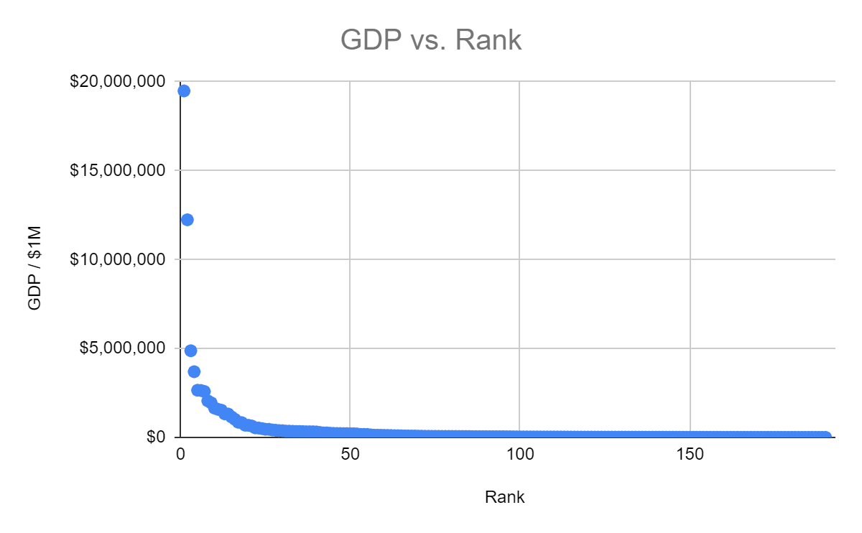
Distribution of wealth by Countries
Rank Country GDP % of total
1 United States $19.485 trillion 24.08%
2 China $12.238 trillion 15.12%
3 Japan $4.872 trillion 6.02%
4 Germany $3.693 trillion 4.56%
5 India $2.651 trillion 3.28%
6 United Kingdom $2.638 trillion 3.26%
7 France $2.583 trillion 3.19%
8 Brazil $2.054 trillion 2.54%
9 Italy $1.944 trillion 2.40%
10 Canada $1.647 trillion 2.04%
11 Russia $1.578 trillion 1.95%
12 South Korea $1.531 trillion 1.89%
13 Australia $1.323 trillion 1.64%
14 Spain $1.314 trillion 1.62%
15 Mexico $1.151 trillion 1.42% …
190 Tuvalu $40 million 0.00%

Slide 4
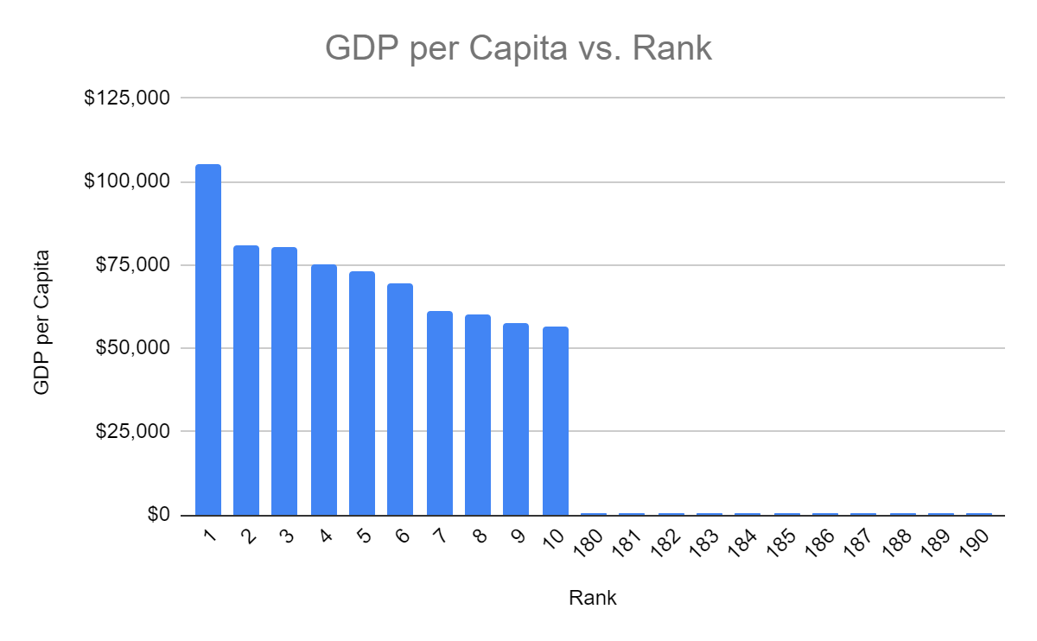
GDP per Capita
Rank Country GDP Population GDP per Capita
1 Luxembourg $62.32 billion 591,910 $105,280
2 Macao $50.36 billion 622,585 $80,890
3 Switzerland $679 billion 8,455,804 $80,296
4 Norway $399 billion 5,296,326 $75,428
5 Iceland $24.49 billion 334,393 $73,233
6 Ireland $331 billion 4,753,279 $69,727
7 Qatar $167 billion 2,724,728 $61,264
8 United States $19.48 trillion 325,084,756 $59,939
9 Denmark $330 billion 5,732,274 $57,545
10 Singapore $324 billion 5,708,041 $56,746
180 Micronesia $336 million 532,899 $631
181 Togo $4.76 billion 7,698,474 $618
182 Afghanistan $19.54 billion 36,296,113 $538
183 Sierra Leone $3.78 billion 7,488,423 $504
184 DR Congo $37.64 billion 81,398,764 $462
185 Madagascar $11.50 billion 25,570,512 $450
186 Mozambique $12.65 billion 28,649,018 $441
187 Central African Republic $1.95 billion 4,596,023 $424
188 Niger $8.12 billion 21,602,382 $376
189 Malawi $6.30 billion 17,670,196 $357
190 Burundi $3.17 billion 10,827,019 $293

Slide 5
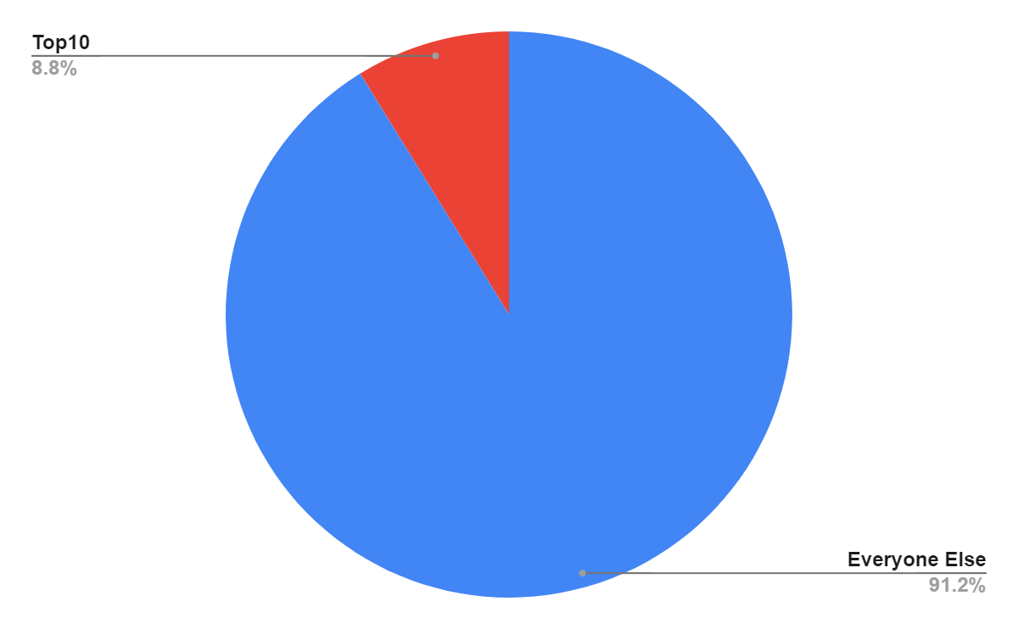
Richest people
As of 2021
There are 7.9 billion people on Earth
There are 2,755 billionaires on Earth
Estimated total net worth of $13.1 trillion
The top 10 wealthiest people in the account for $1,153 billion
~0.36% of billionaires account for 8.8% of this total

Slide 6
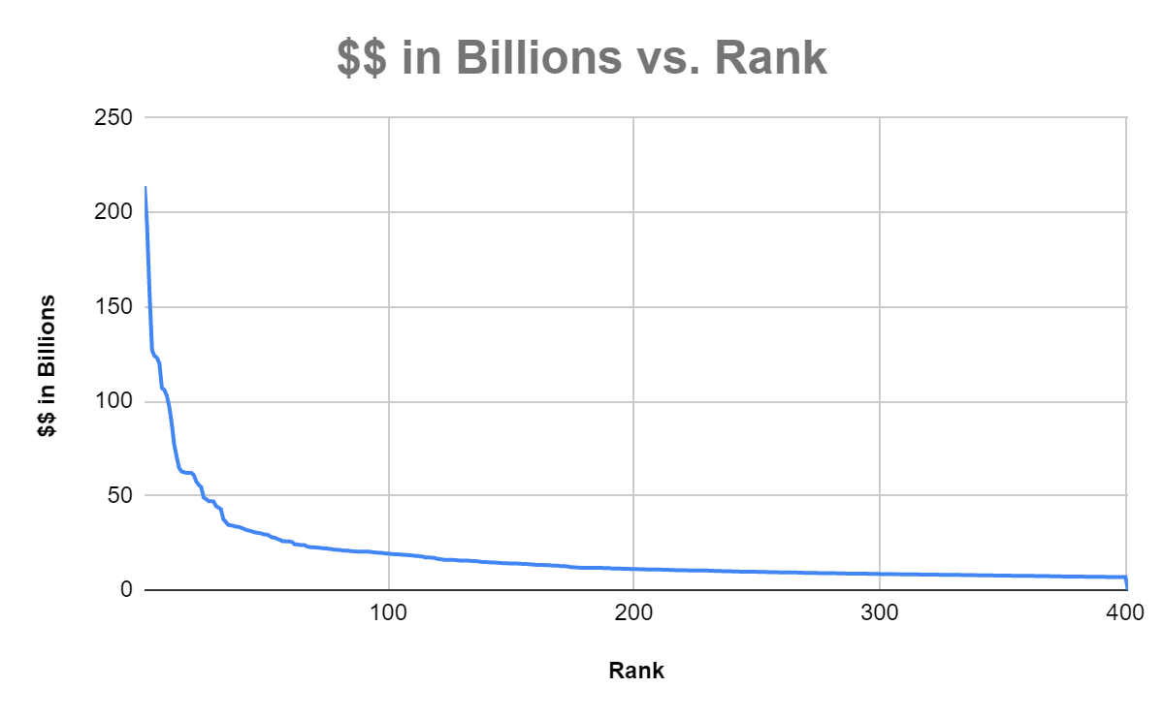
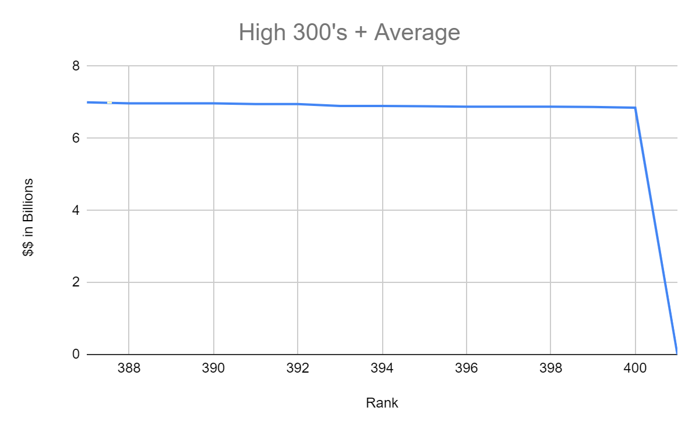
Richest people
Elon Musk $214 billion
Jeff Bezos $192 billion
Bernard Arnault $157 billion
Bill Gates $127 billion
Larry Page $124 billion
Mark Zuckerberg $123 billion
Sergey Brin $120 billion
Larry Ellison $107 billion
Steve Ballmer $106 billion
Warren Buffett $103 billion
…
400. Yu Renrong $6.85 billion Average Person $170k
As of October 7, 2021

Slide 7
All Billionaires
If the 2,755 billionaires were a country, the combined $13.1 trillion would rank #2
United States $19.485 trillion
Billionaires $13.1 trillion
2 China $12.238 trillion
3 Japan $4.872 trillion
4 Germany $3.693 trillion
5 India $2.651 trillion

Slide 8
Top 10 Billionaires
If the top 10 billionaires were a country, the combined $1,153 billion would rank #15
10 Canada $1.647 trillion
11 Russia $1.578 trillion
12 South Korea $1.531 trillion
13 Australia $1.323 trillion
Spain $1.314 trillion
Billionaires $1.153 trillion
15 Mexico $1.151 trillion

Slide 9
Richest Person
If the richest person were a country, $214 billion would rank #48
45 Vietnam $224 billion
46 Portugal $219 billion
Czech Republic $216 billion
Elon Musk $214 billion
48 Romania $212 billion
49 Peru $211 billion
50 New Zealand $204 billion

Slide 10
Elon Musk’s earning rate
$2,284,044,884.00 Per Year
$6,257,657.00 Per Day
$260,736.00 Per Hour
$4,345.60 Per Minute

Slide 11
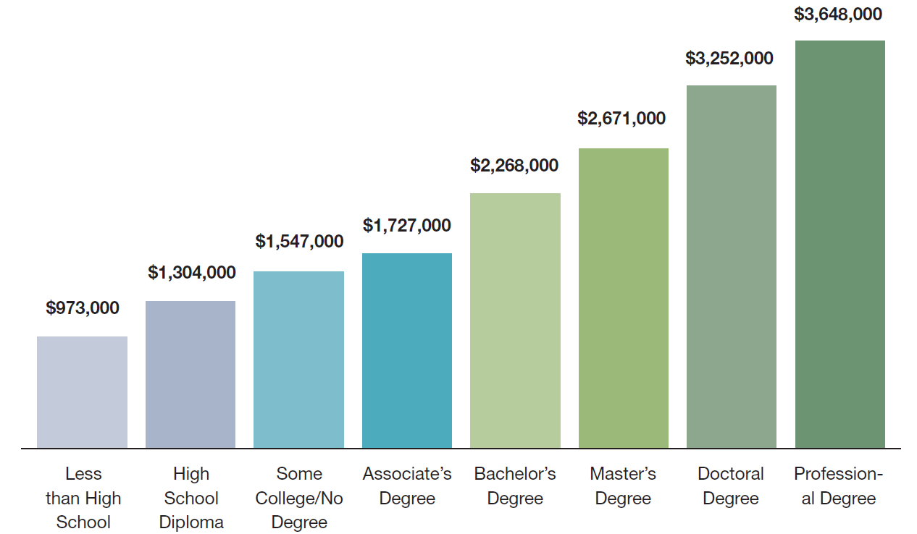
How long for Elon Musk to earn lifetime income
3.73 Hours
5.0 Hours
5.93 Hours
6.62 Hours
8.70 Hours
10.24 Hours
12.47 Hours
13.99 Hours
https://cew.georgetown.edu/wp-content/uploads/2014/11/collegepayoff-complete.pdf

Slide 12
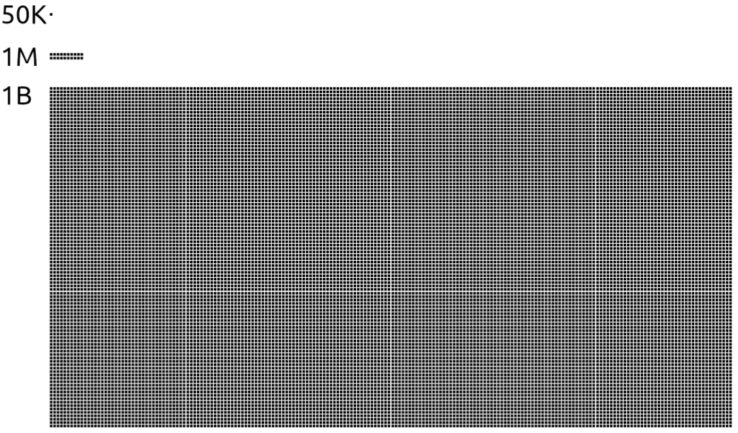
Scale
https://www.abc.net.au/triplej/programs/hack/amazon-boss-jeff-bezos-worth-as-much-as-new-zealand-economy/12481466

Slide 13
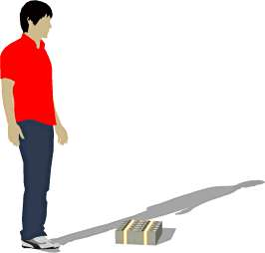
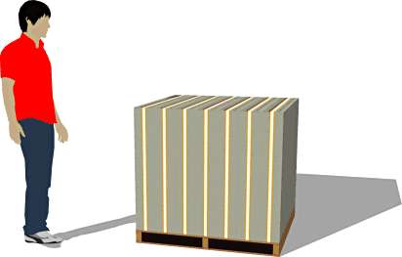
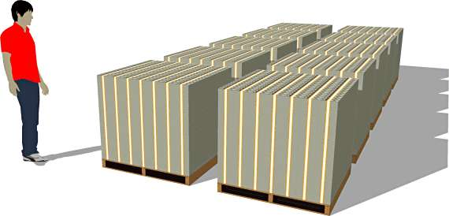
What $$ looks like
$1,000,000
$100,000,000
A Billion Dollars
https://www.commoncentsmom.com/what-a-billion-dollars-looks-like/

Slide 15
Backup Slides

Slide 16
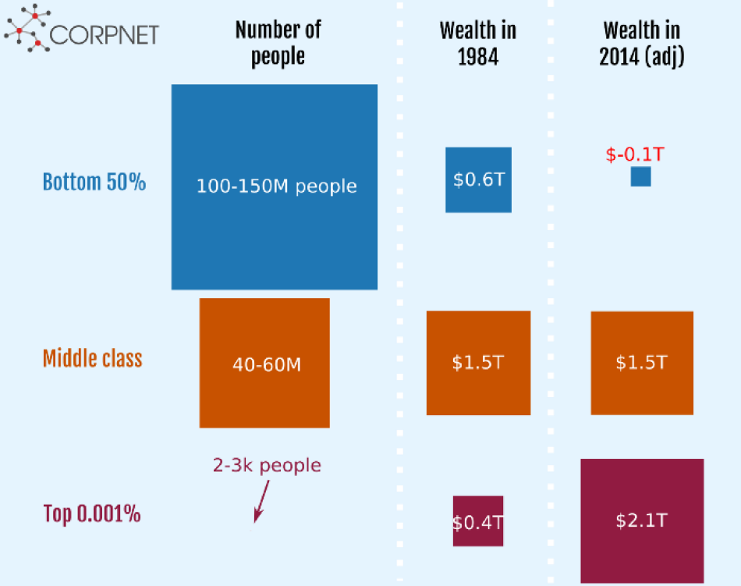
Distribution of wealth
https://www.abc.net.au/triplej/programs/hack/amazon-boss-jeff-bezos-worth-as-much-as-new-zealand-economy/12481466

Slide 17
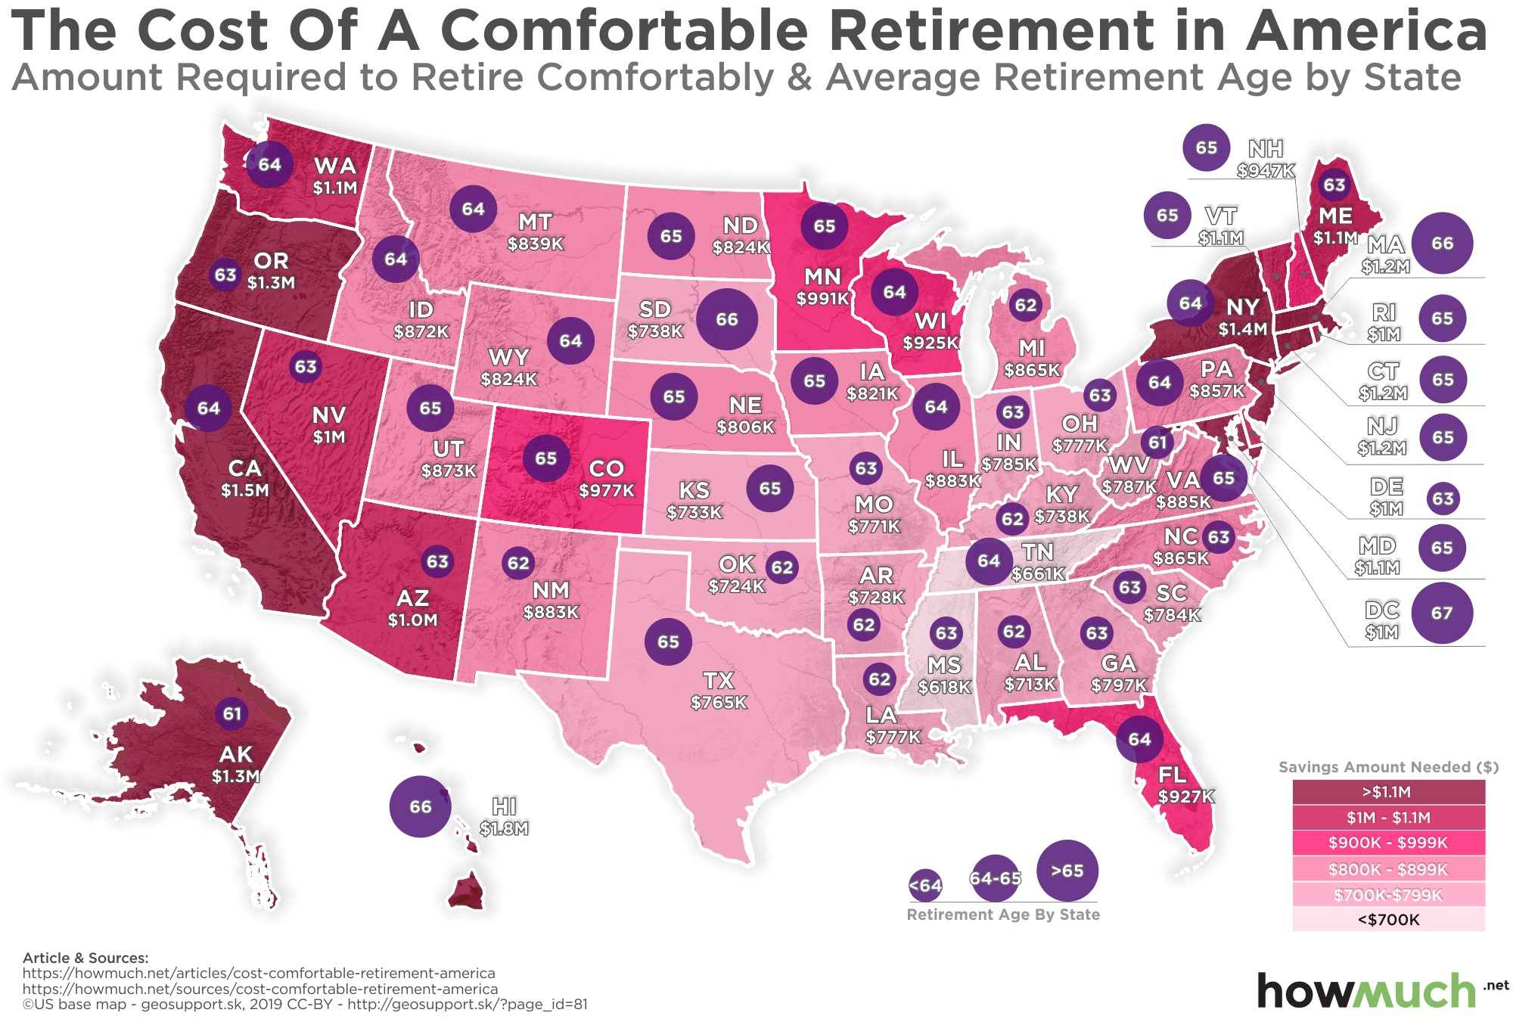
The range for a comfortable retirement is
$1.5M - $618K
This amount is expected to last you the rest of your life assuming a reasonable withdraw rate
https://howmuch.net/articles/top-10-data-visualizations-2019

Slide 18
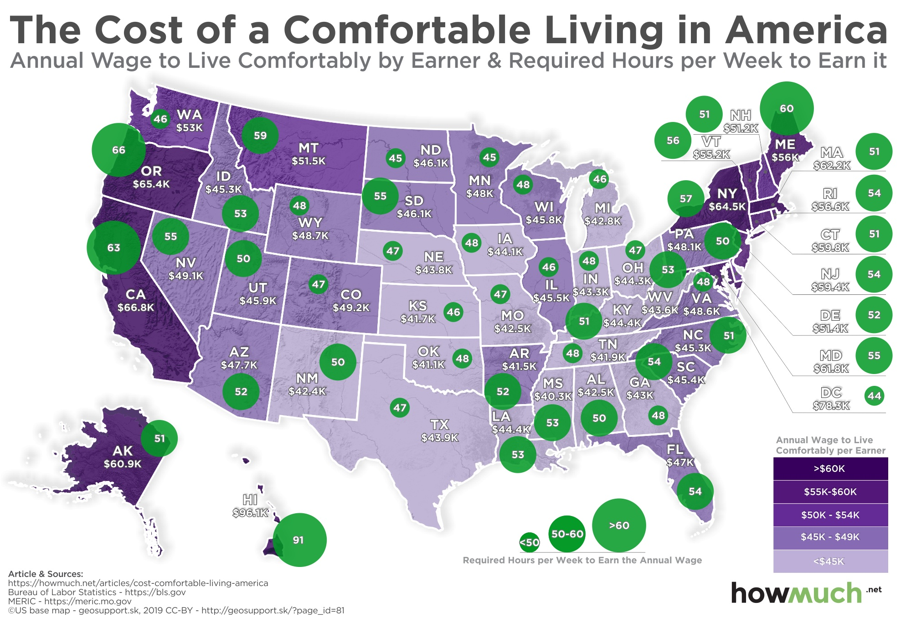
The range for a comfortable living is
$67k - $41.1k
https://howmuch.net/articles/cost-comfortable-living-america

Slide 19
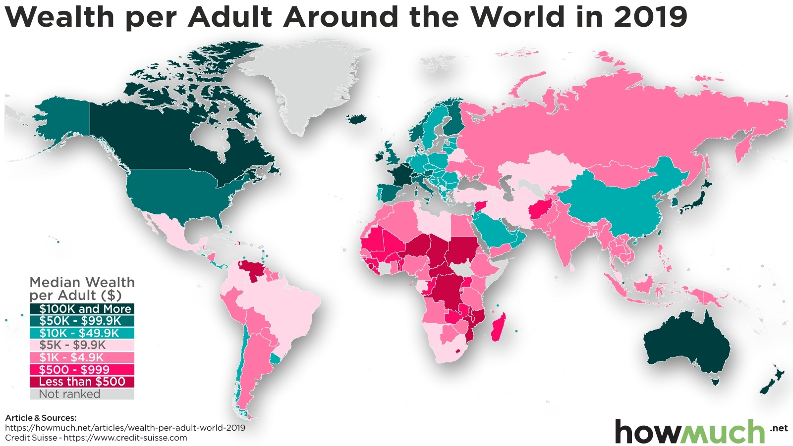
https://howmuch.net/articles/wealth-per-adult-world-2019

Slide 20
Averages
As of 2021
There are 7.9 billion people on Earth
If money were evenly distributed, each person would get (1.34q / 7.9b) ~$170K
https://www.rankred.com/how-much-money-is-there-in-the-world/

Slide 21
Title
ds

